Slide 1
IT1762
Data Structures & Algorithms
Topic 3B Methods
with Return Value

Slide 2
Topics
Methods with return values
Passing data using parameters and return values
Objectives:
Know how to return values from a method
Know how to make use of return values from methods

Slide 3
Review : Passing data between methods
Methods can pass data to each other as follows:
  Through Class Variables
  By using Parameters
  By returning a value from a method.
We have covered 1) in IT1753
We have covered 2) in Topic 4a
  Methods with passing parameter
We shall 3) in this session.

Slide 4

Structure of a
Method with Parameter
return type: void means the method is not returning any value to the calling program.
Name of method
private void MethodName ( parameter )
{
statement;
statement;
}
a pair of parentheses or round brackets to contain parameters
a pair of braces or curly brackets denote the method body containing C# statements
[ Recap : What we
have learnt in Topic 4A]

Slide 5
Constraint in
Method with Parameter
Method with parameters allow us to pass values into method
It allows method to made copy of the values and use it
BUT, often we need to code methods which perform a calculation and send a result back to the rest of the program
So that we could use the result subsequent calculations.
Let’s look at :
Method with Parameter and
Return Value

Slide 6
Structure of a
Method with Parameter and
Return Value
return data type: int means the method is returning an integer value to the calling program. It can be double, string, char etc
Name of method
Private int MethodName ( parameter )
{
statement;
statement;
return __________;
}
a pair of parentheses or round brackets to contain parameters
a pair of braces or curly brackets denote the method body containing C# statements
Type of item that the method will return to the caller.
Method can only return ONE item or value

Slide 7
Example1:CalculatePay
(a) Write a method CalculatePay( ) that Receives a integer parameter , hrsWorked . It computes the pay and Returns the computed pay based on the following rules:
Pay = $12 per hour x number of hours worked
Method receives a integer parameter, int hrsWorked
hrsWorked is a local variable in CalculatePay()
private float CalculatePay(int hrsWorked)
{
float pay; // pay is local variable
pay = hrsWorked * 12f;
return pay;
}
At the end of CalculatePay method, it returns pay to the calling method.
Return type is a float, therefore pay MUST be float

Slide 8
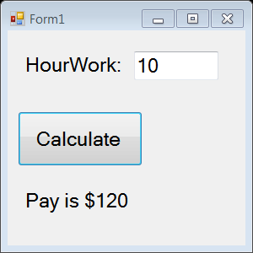
Example1:CalculatePay
(b) Write a window application using button, textbox and label GUI. It reads in the hours worked from textbox, and call the method CalculatePay() and pass it the hours worked as an ARGUMENT. The program stored and display the computed value returned by the CalculatePay( ) method.
private void btnCalculate_Click(object sender, EventArgs e)
{
int hour = int.Parse(txtHour.Text);
float result;
// call method
result = CalculatePay(hour);
lblResult.Text = "Pay is $" + result;
}
It calls CalculatePay method. It returns a float value and is stored in float variable, result.
It is then display in lblResult.Text

Slide 9
Method Definition with parameters and return value
Syntax :
  {
  //statements;
  …
  }
Parameters are places that hold variable values from the calling program. They are declared (just like variables)
They are LOCAL variables to the Method
Method computes the result
Store result and return result
  private float GetPay ( int hoursWorked)
  {
  float result
  // hoursWorked is a local variable
  // compute result
  return result;
  }
It can be float, int, double, string…
private returntype MethodName(parameters)
GetPay is the method name
Parameter is hoursWorked
float Value to be returned to the calling method

Slide 10
Summary
Know how to pass data between methods using Argument/Parameter passing and Return value
In a void method ie there is no return value.
Method can only return ONE value
The return statement allows the method to return the computed value to the calling method

Slide 11
Spot the ERRORs
Private int MethodA ( x )
{
int result;
result = x + 5;
MessageBox.Show(“value is ” + result);
return ;
}
private void MethodB( )
{
int y=10;
int z;
MethodA(y); // calling method
MessageBox.Show(“value is ” + z);
}

Slide 12
Spot the ERRORs
Answer
Private int MethodA ( int x )
{
int result;
result = x + 5;
MessageBox.Show(“value is ” + result);
return result ;
}
private void MethodB( )
{
int y=10;
int z;
z = MethodA(y); // calling method
MessageBox.Show(“value is ” + z);
}
}

Slide 13
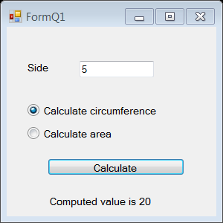

Practical 3B
Q1. Write a window application using simple GUI with textboxes,
labels, radio button to do the following:
It reads a value from a textbox into a variable called side
User selects an option using radio button.
The options are
  Calculates circumference,
    where circumference = 4 * side.
  Calculates area,
    where area = side * side.
c. When user clicks on Calculate button, it calls the respective method. The calling method computes the result and returns the result. It displays it using a label.
Both calculations of circumference and area are implemented as methods that receive a parameter, double side and return a double result.
Here is a sample code to help you!
private double CalculateCircumference( ___________ )
{
double ________________ ;
circumference = _________________ ;
return _________________;
}

Slide 14
Practical 3B
private ________ CalculateArea( ___________ )
{
double ________________ ;
area = _________________ ;
return _________________;
}
private void btnCalculate_Click(object sender, EventArgs e)
{
double side = double.Parse(txtSide.Text);
double result = 0;
if (rbtnCir.Checked== true)
{
// call method
______ = CalculateCircumference(______);
}
else if (rbtnArea.Checked== true)
{
______ = CalculateArea(________);
}
else
{
MessageBox.Show("You did not select any radio button");
}
lblResult.Text = "Computed value is " + result;
}

Slide 15
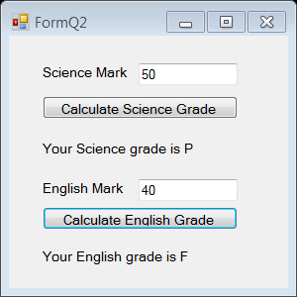
Practical 3B
Method with parameter and return value – reusability of methods
Q2a) Write a method CalculateGrade( ) that accepts a integer
student mark as a parameter, and returns the computed
Grade (P for pass or F for fail). A mark of 50 and above is
pass, and below that is a fail.
2b) Write a window application using simple GUI do the
following:
It reads in student’s Science subject mark from a textbox.
User clicks on Calculate Science Grade button, it calls CalculateGrade method. It receives the Science mark and returns the computed Grade.
Program displays the computed grade for the science subject returned from the method in a label
It reads in student’s English subject mark from a textbox.
User clicks on Calculate English Grade button, it calls CalculateGrade method. It receives the English mark and returns the computed Grade.
Program displays the computed grade for the English subject returned from the method in a label

Slide 16
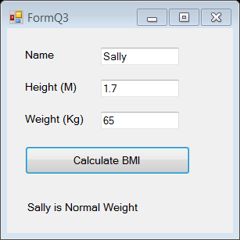
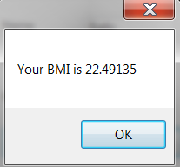
Practical 3B
Method with parameter and return value – reusing methods
Q3. Write a window application using simple GUI with
textboxes, labels, button to do the following:
It reads in a name (e.g john), the height (in metres) and weight (in kg) of John
User clicks on Calculate BMI button. It calls a method called CalculateBMI that receives 2 parameters, the height and weight of John. It calculates the Body Mass Index (BMI) based on the following formula:
BMI = weight (kg)
height (m) x height (m)
The CalculateBMI method displays the BMI value in a message box and returns relevant message.
BMI Message to display
Less than 18.5 Under weight
18.5 to below 25 Normal weight
25 to below 30 Overweight
30 and above Obese
c. Program displays the name and BMI message returned from the method in a label. See figure.
Try to run the application with
different input e.g name is Sally,
height is 1.7M and weight is 65kg.
By calling the same method
(CalculateBMI), the new
result will
be displayed.

Slide 17
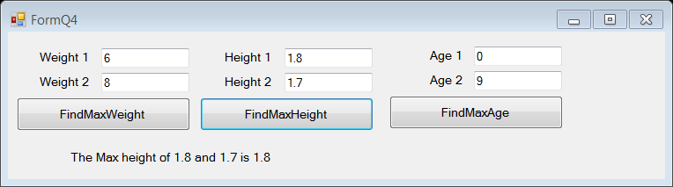
Practical 3B
Reusability of method
Q4. Write a method FindMax that receives 2 float parameters, returns the greater float value to the calling method.
Write a window application using simple GUI with textboxes, labels, button to do the following:
It reads in weights (in KG) of 2 persons from 2 textboxes.
User clicks on FindMaxWeight button. It calls FindMax method and passes in the 2 weight variables. It displays the returned value (greater weight) in the label.
It reads in heights (in M) of 2 persons from 2 textboxes.
User clicks on FindMaxHeight button. It calls the above method FindMax method and passes in the 2 height values. It displays the returned value (greater height) in the label.
It reads in age of 2 persons (in Year) from 2 textboxes
User clicks on FindMaxAge button. It calls the above method FindMax and passes in the 2 age values . It displays the returned value (older age) in the label.
When user clicks on FindMaxHeight, it displays in a label with max height is 1.8 for 1.8 is bigger than 1.7.

Slide 18
Practical 3B
Reusability of method
Q5. From question 4, think about its application :
  How many FindMax method did you write?
  How many times did you call the FindMax method in the application?
  Compare this solution with Practical 4A Q7, any difference? Which is better?
  What did you observe in this program? How do you “reuse” Method?

Slide 19
IT1762
Data Structures & Algorithms
End of
Topic 3B Methods
with Return Value

